Slide 1
Mindfulness - Part III
Review – Everyday Mindfulness
How does breathing calm the brain?
Breathing Techniques
More Breathing Techniques
Circle of Control
Flipping Your Lid (FYL)
FYL Explained
Click the speaker icon below to listen to the introduction of Mindfulness- Part III

Slide 2
Return to Home

Slide 3
Return to Home

Slide 4
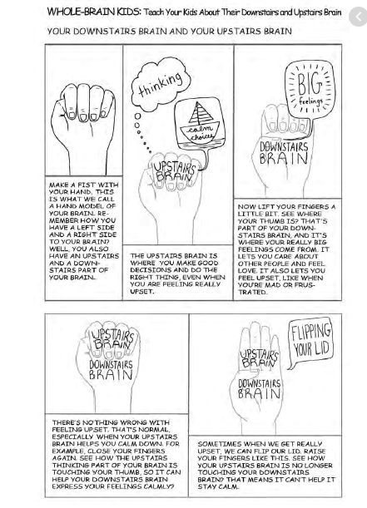
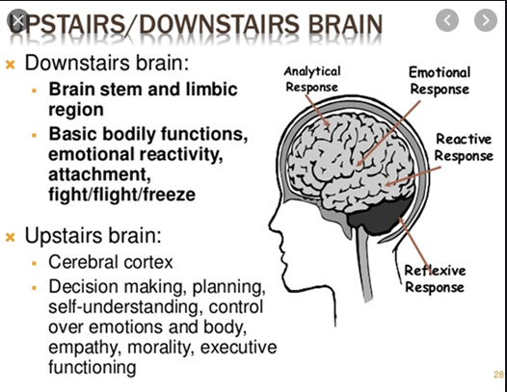
Flipping Your Lid ( FYL)
Return to Home

Slide 5
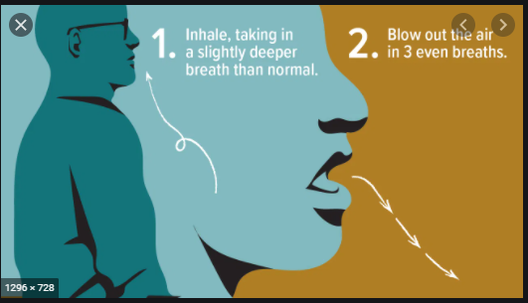
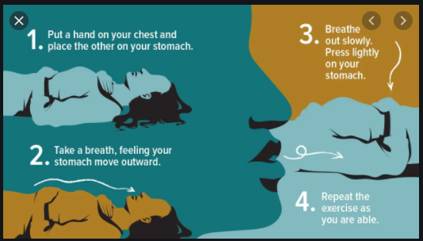
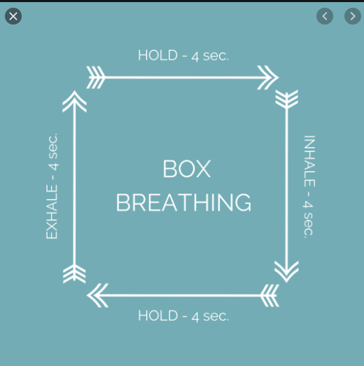
Return to Home

